Slide 1
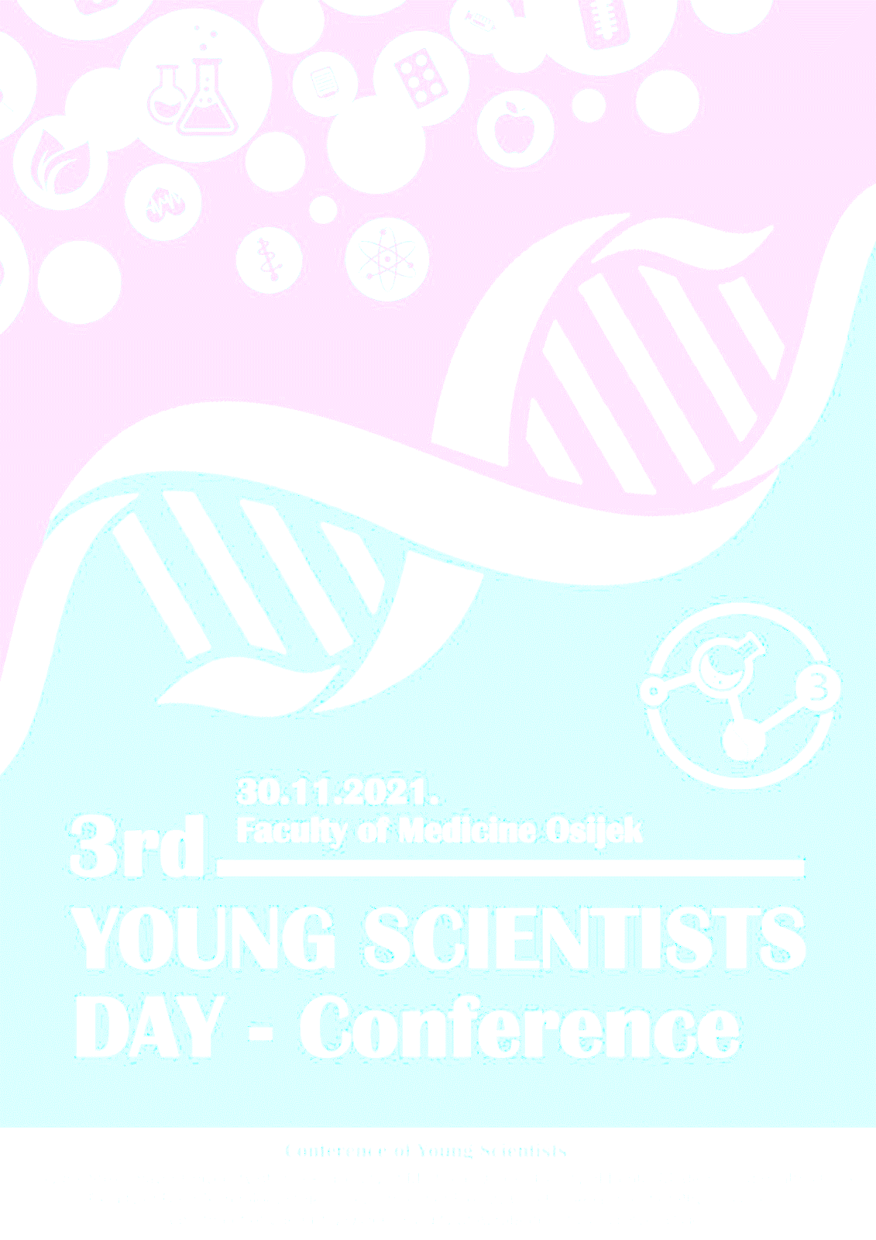
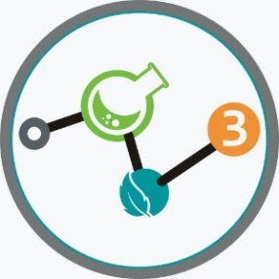
YOUNG
SCIENTIST
DAY
2021
Application of cocoa shell in chocolate production
V. Barišić*, I. Flanjak, Đ. Ačkar
Josip Juraj Strossmayer University of Osijek, Faculty of Food Technology Osijek, Franje Kuhača 18, 31000 Osijek, Croatia
*vbarisic@ptfos.hr
This work has been supported in part by Croatian Science Foundation under the project “Application of cocoa husk in production of chocolate and chocolate-like products” (UIP 2017-05-8709).

Slide 2
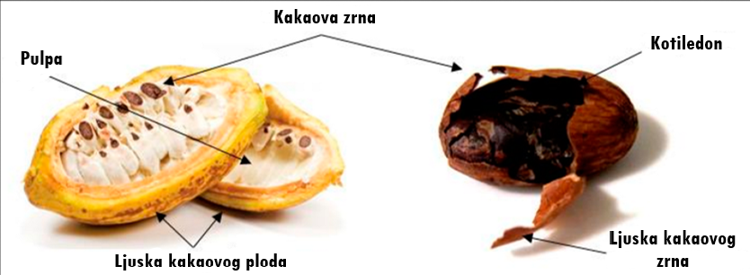
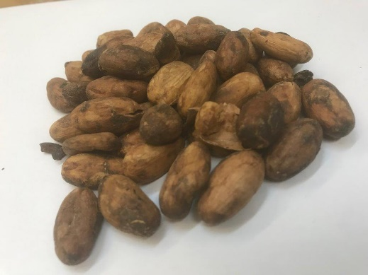
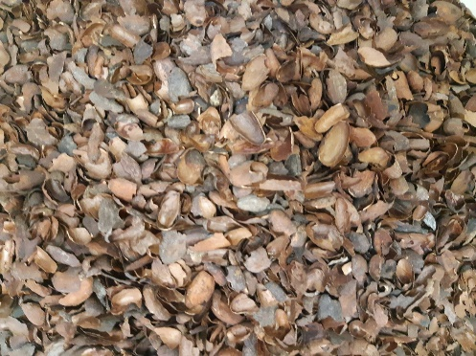
Cocoa shell
2021
By-product of chocolate industry
Removed before or after roasting
Rich in fibers, proteins, bioactive components, etc.
Protects the bean
It’s used as animal feed, mulching, production of biodiesel, adsorbents, extraction of bioactive components, researched as food component…
2

Slide 3
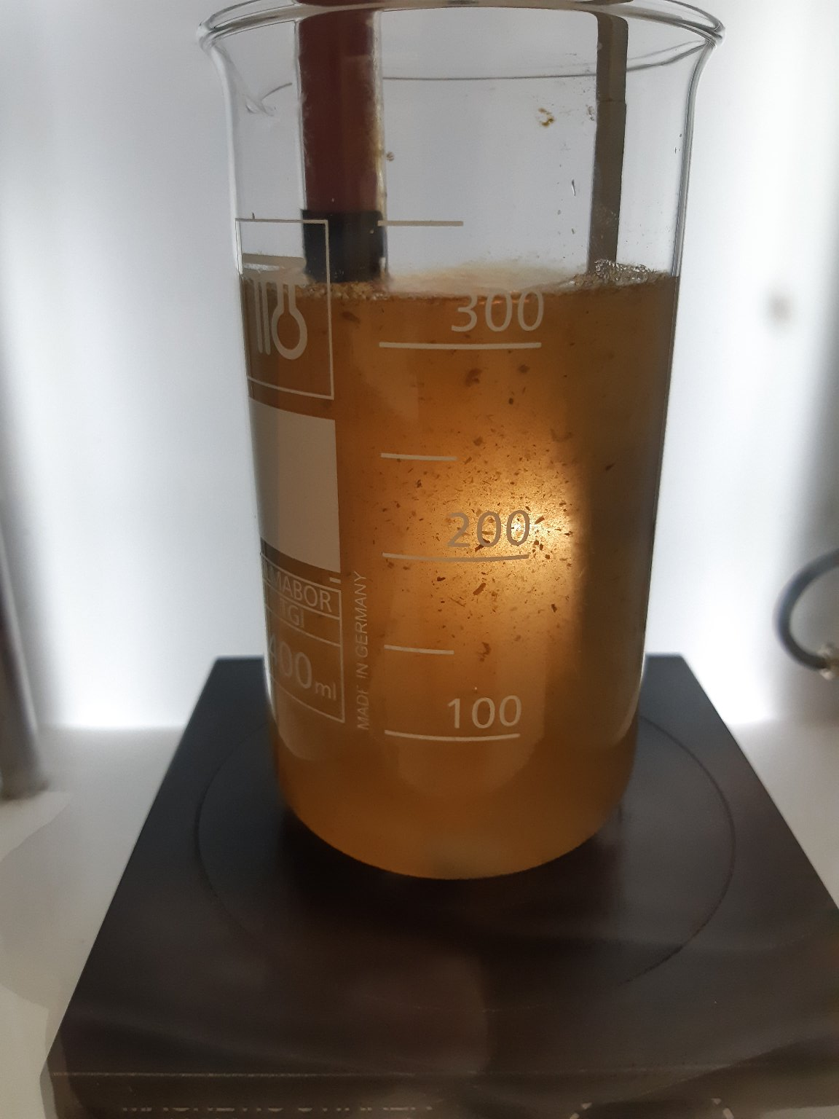
High voltage electrical discharge (HVED)
2021
Nonthermal method
Formation of discharge directly in solvent
Formaton of radicals, electrons, ozone, UV-light, etc.
Can be used as method for disinfection, cell wall destruction, extraction, material modification…
3rd YOUNG SCIENTIST DAY – PhD Conference
4

Slide 4
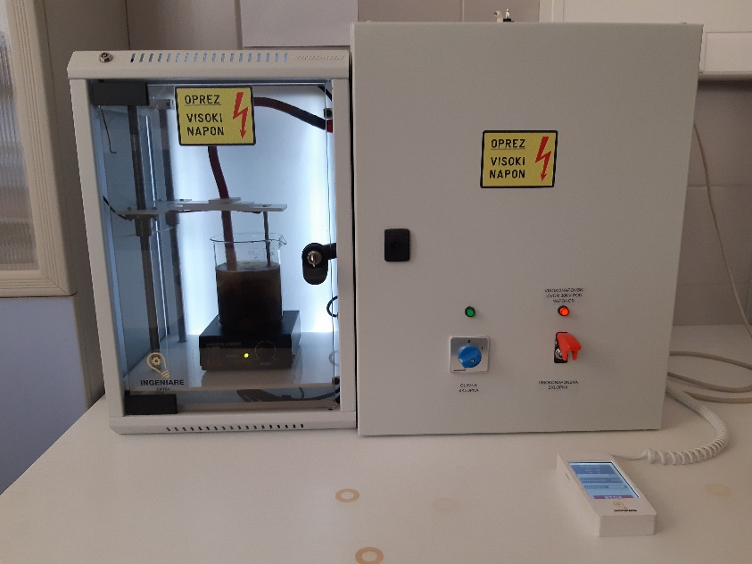
High voltage electrical discharge (HVED)
2021
Effect of HVED on cocoa shell:
Hydroxymethylfurfural and acrylamide
Microorganisms
Modification of cell wall
3rd YOUNG SCIENTIST DAY – PhD Conference
4

Slide 5
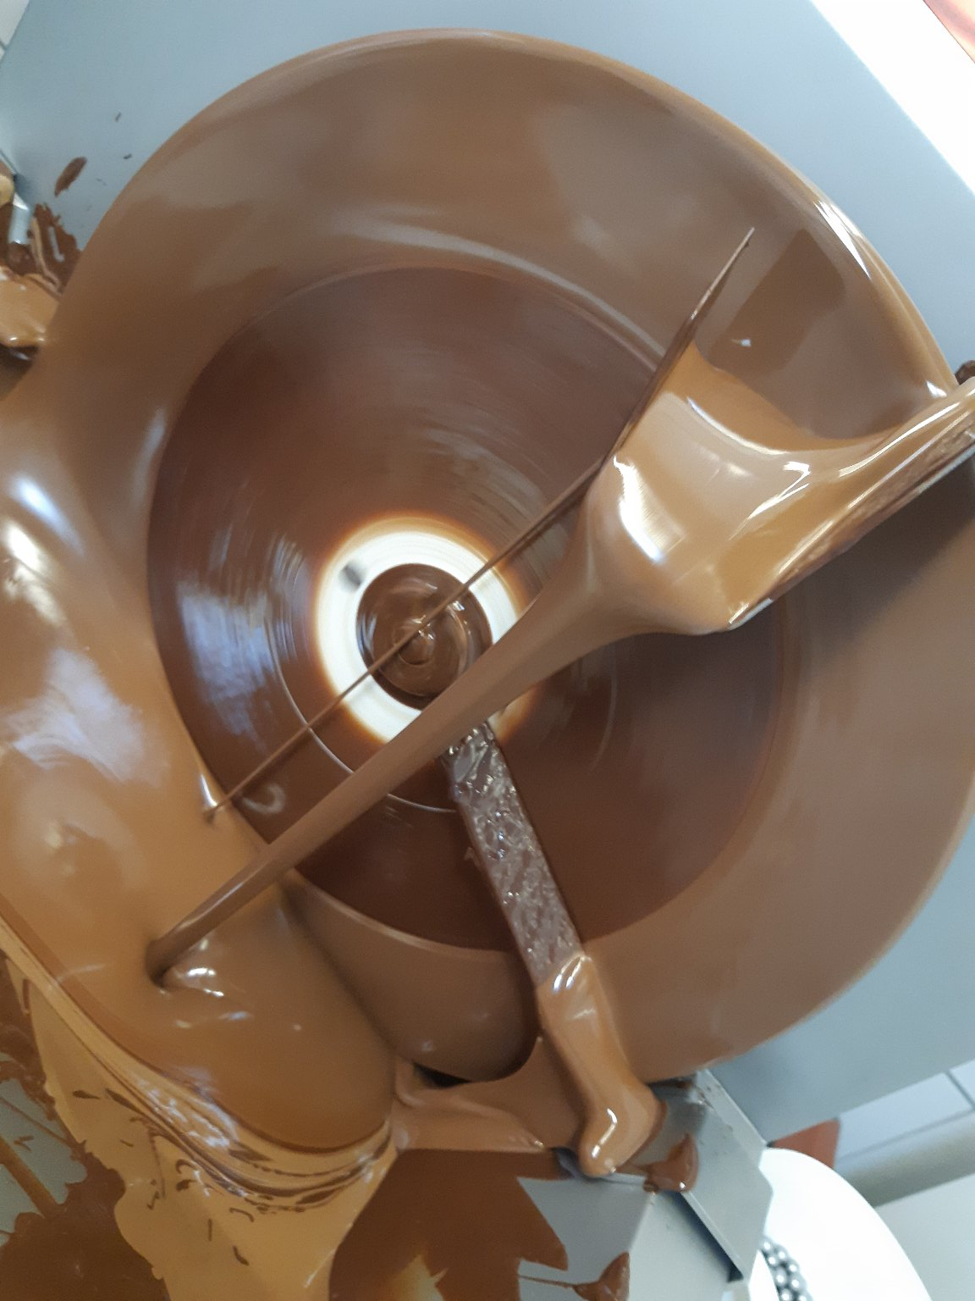
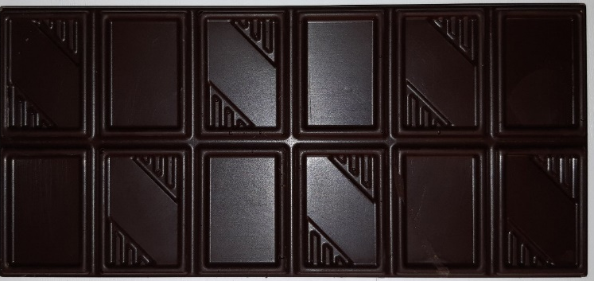
Cocoa shell in chocolate production
2021
Production in ball mill
Increased content of dietary fibers
Polyphenols – not statistically different
Effect on texture, viscosity, particle size distribution, color
3

Slide 6
2021
THANK YOU
FOR YOUR
ATTENTION!!!
Supporting publication
https://istrazivaci-os.com.hr/
ISBN 978-953-7736-55-2
3rd YOUNG
SCIENTIST
DAY 2021

