Slide 1

Can Chocolate Be More Nutritious and Sustainable?
Đurđica Ačkar, Veronika Barišić, Ivana Flanjak, Jurislav Babić
Josip Juraj Strossmayer University of Osijek, Faculty of Food Technology Osijek, Croatia

Slide 2
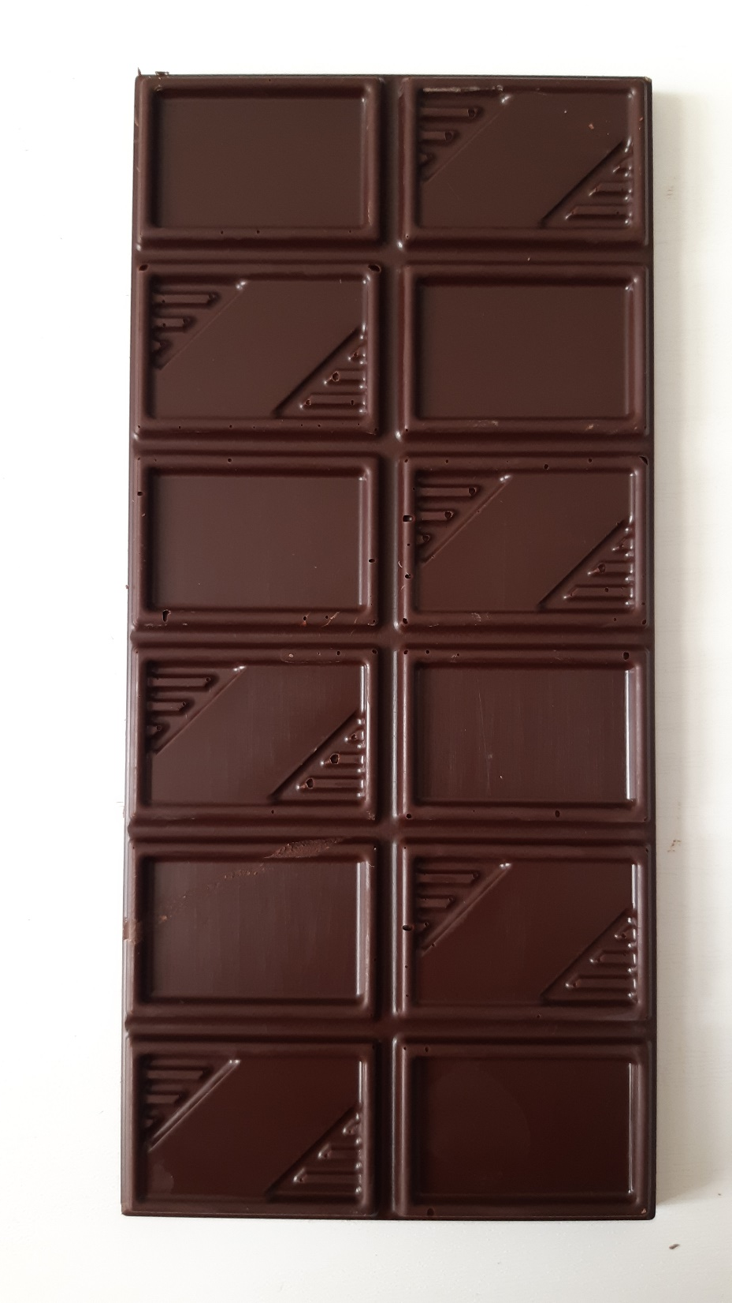
Chocolate – benefits and issues
Nutritional:
Sugar, cocoa, (milk), substitute fats, emulsifier
  Cocoa – polyphenols, Mg
  Milk – Ca
  Sugar, cocoa butter, fats – calories
Environmental:
Cocoa by-products – pod husk, bean shell, germ
Pod husk – fertilizer
Bean shell – attempts: mulching, biofuel, fuel, animal feed

Slide 3
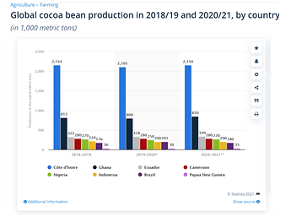
Cocoa bean shell
App. 12 – 20 % of the bean
2020/21: 4,305,000 metric tonns of cocoa bean produced in 8 countries – 688,800 metric tonns of cocoa shell

Slide 4
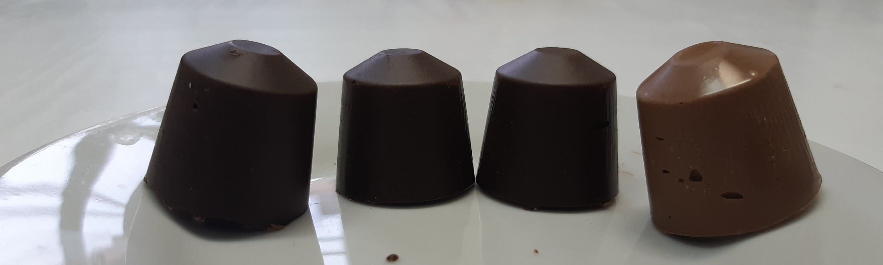
Cocoa bean shell

Slide 5
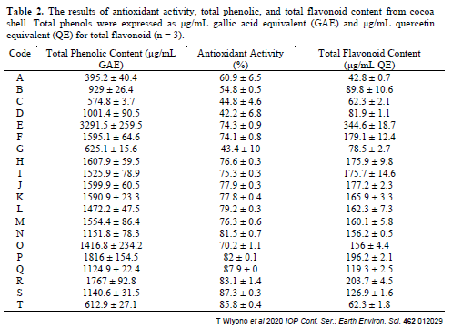
Cocoa bean shell

Slide 6
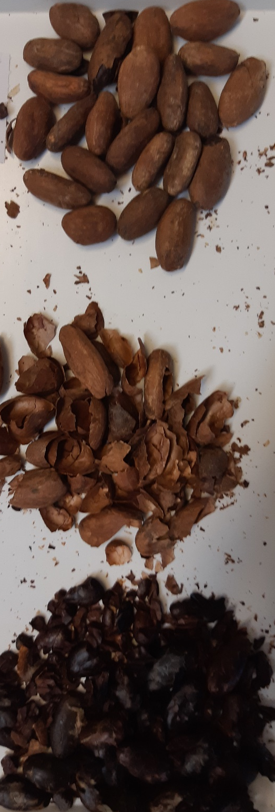
Cocoa bean shell
Mulching
Adsorption
Animal feed
Food – chocolate (?):
  Project “Application of cocoa husk in production of chocolate and chocolate-like products” (UIP 2017-05-8709) financed by Croatian Science Foundation

Slide 7
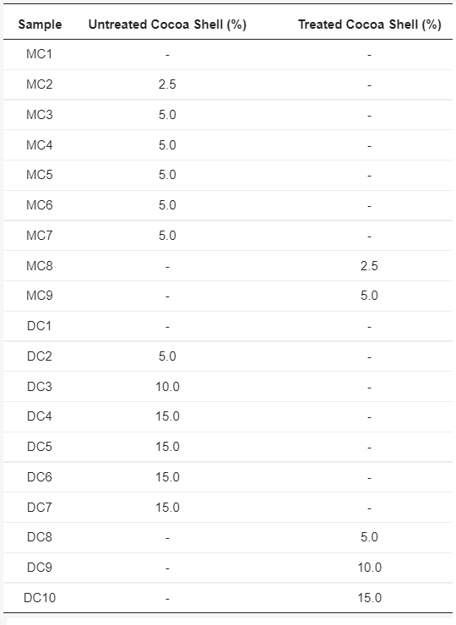
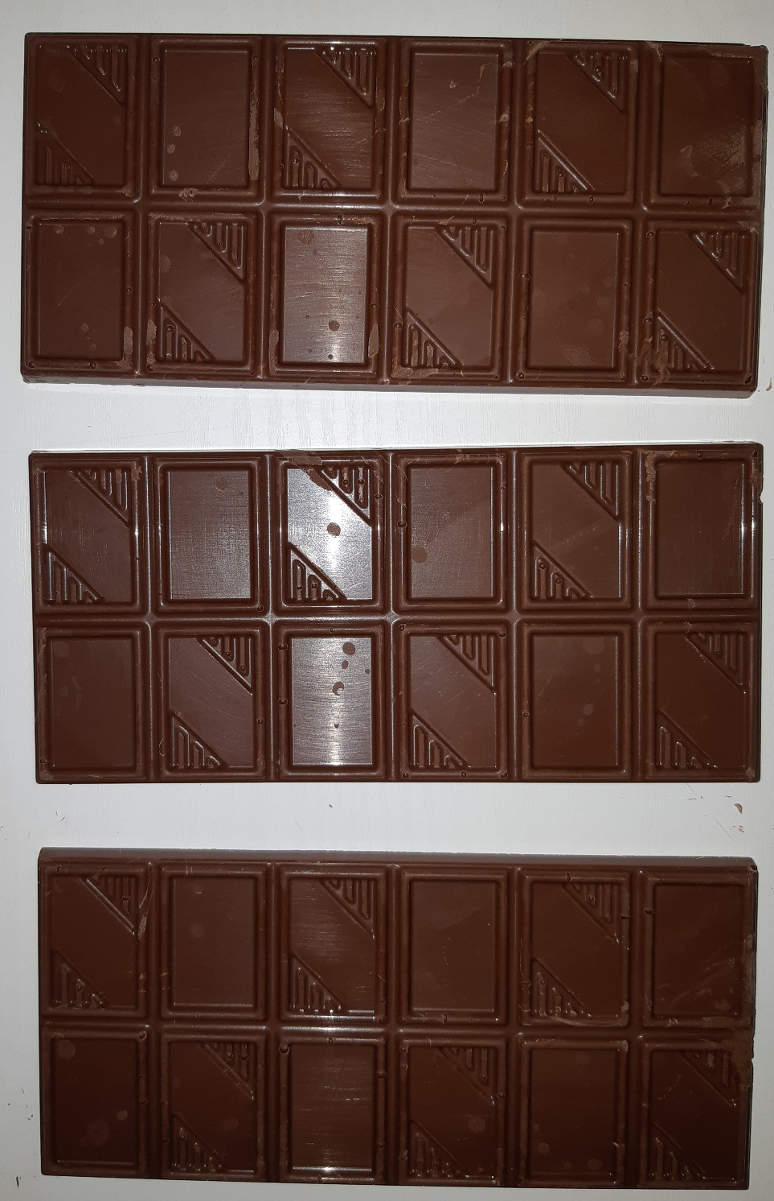
Chocolate with cocoa bean shell

Slide 8
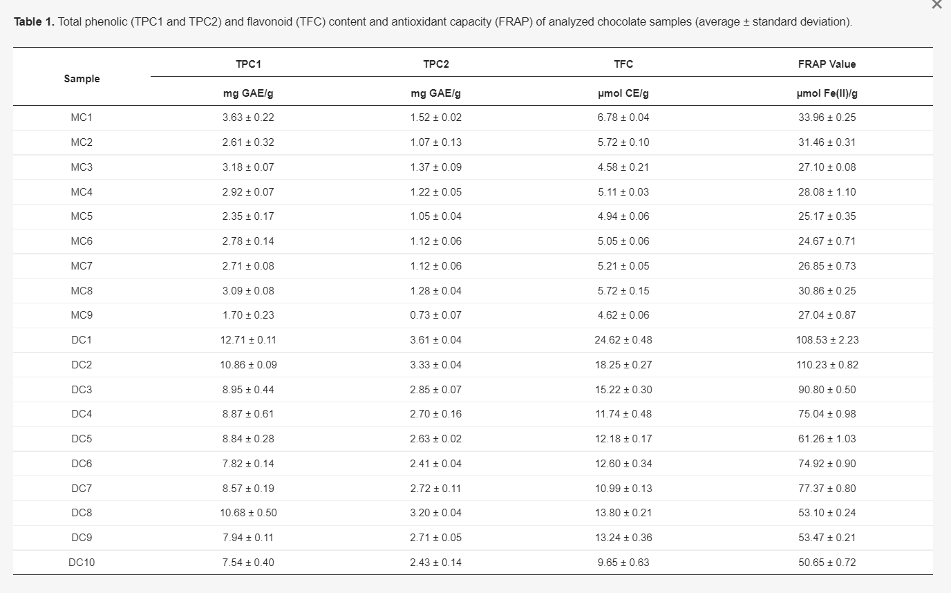
Chocolate with cocoa bean shell

Slide 9
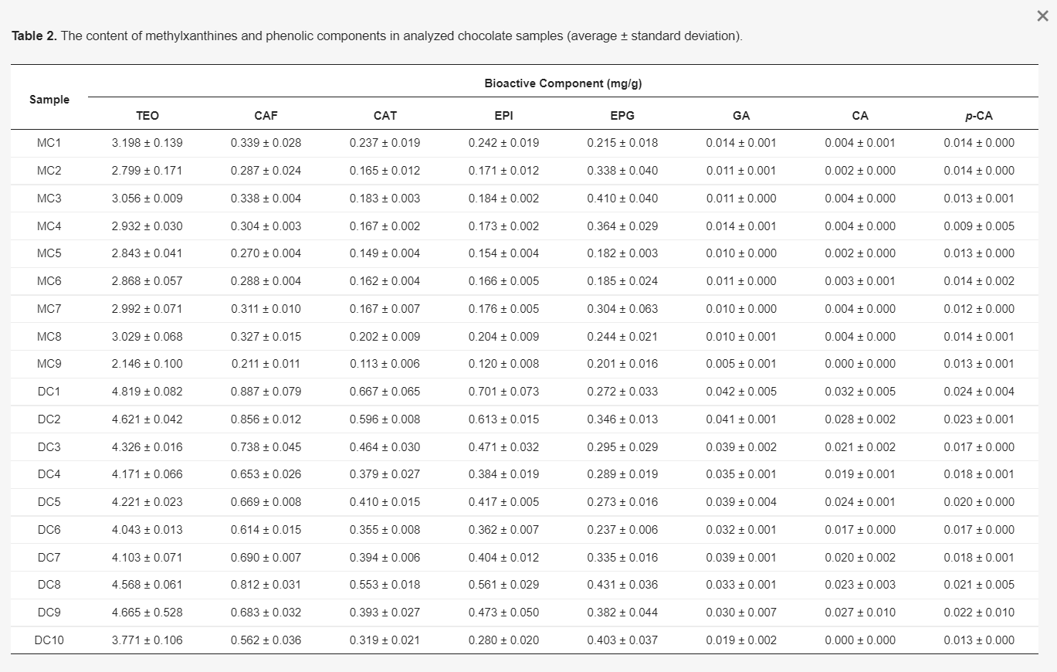
Chocolate with cocoa bean shell

Slide 10
Chocolate with cocoa bean shell
Sample | ⁴⁴Ca (mg/kg) | ²⁴Mg (mg/kg) | ⁵⁶Fe (mg/kg) | ⁵⁷Fe (mg/kg)
D0 | 540.34 ± 85.60ª | 1155.27 ± 15.23^{c} | 202.93 ± 5.00^{c} | 205.17 ± 5.19^{c}
DU5 | 652.65 ± 122.98ª | 1193.20 ± 6.97^{d} | 293.83 ± 2.02e | 298.37 ± 3.90^{f}
DU10 | 867.41 ± 41.96^{b} | 1246.40 ± 8.97e | 328.33 ± 5.09^{f} | 333.00 ± 4.85^{g}
DU15 | 908.28 ± 12.08^{b} | 1313.01 ± 16.19^{g} | 333.50 ± 5.78^{f} | 338.53 ± 3.76^{g}
DT5 | 912.39 ± 51.77^{b} | 1173.36 ± 28.37^{c,d} | 285.67 ± 6.34e | 289.73 ± 4.50^{f}
DT10 | 1035.90 ± 45.71^{b,c} | 1225.87 ± 7.97e | 290.83 ± 1.68e | 297.77 ± 1.06^{f}
DT15 | 1144.39 ± 28.22^{c} | 1279.24 ± 12.35^{f} | 364.33 ± 6.30^{g} | 369.00 ± 8.08^{h}
M0 | 1855.49 ± 91.29^{d,e} | 639.34 ± 12.17^{a,b} | 90.13 ± 1.45ª | 90.55 ± 1.65ª
MU2.5 | 1802.37 ± 221.42^{d,e} | 620.62 ± 11.34ª | 178.77 ± 2.26^{b} | 182.00 ± 2.65^{b}
MU5 | 1955.02 ± 35.22e | 642.17 ± 4.57^{a,b} | 209.90 ± 4.03^{c} | 217.17 ± 3.61^{d}
MT2.5 | 1687.18 ± 6.02 ^{d} | 620.55 ± 7.49ª | 174.50 ± 3.11^{b} | 177.40 ± 4.68^{b}
MT5 | 1836.20 ± 59.51^{d,e} | 656.47 ± 11.05^{b} | 232.20 ± 3.14^{d} | 241.07 ± 4.82e

Slide 11
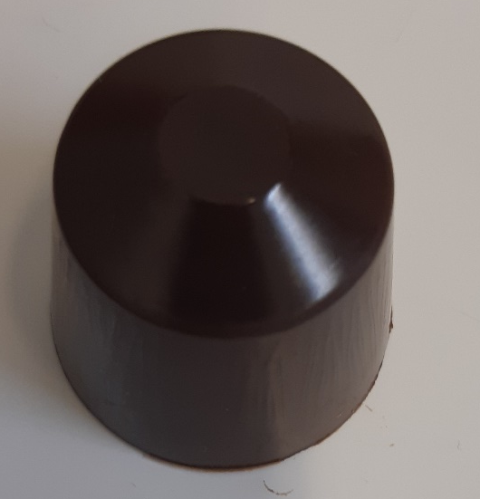
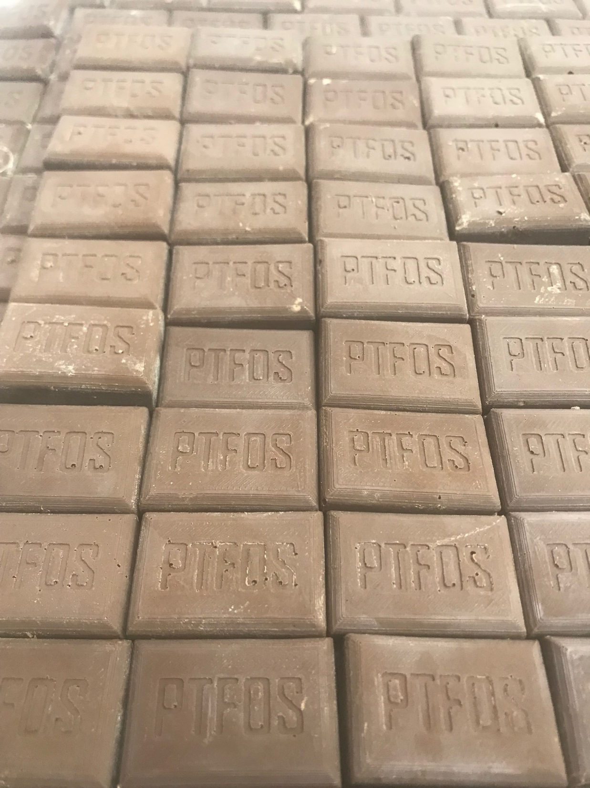
Chocolate with cocoa bean shell
Contents of toxic elements in chocolates with cocoa shell
Sample | ⁶⁰Ni (µg/kg) | ⁵²Cr (µg/kg) | ²⁰⁸Pb (µg/kg) | ¹¹¹Cd (µg/kg) | ²³⁸U (µg/kg)
D0 | 2599.67 ± 41.99^{b} | 2966.17 ± 85.06^{b} | 44.41 ± 3.82^{b} | 18.95 ± 0.34^{b} | <LD
DU5 | 5752.33 ± 119.01e | 10832.60 ± 144.21^{e,f} | 99.84 ± 0.81e | 48.52 ± 1.40^{d} | 0.29 ± 0.00ª
DU10 | 6760.67 ± 148.36^{g} | 12892.16 ± 128.73^{h} | 139.17 ± 3.63^{f} | 74.71 ± 1.34e | 2.24 ± 0.63^{b}
DU15 | 6677.33 ± 65.11^{g} | 12521.12 ± 249.23^{h} | 194.10 ± 2.50^{h} | 101.73 ± 1.46^{g} | 6.32 ± 0.55^{c}
DT5 | 5776.33 ± 111.88e | 11104.24 ± 259.09^{f} | 91.50 ± 1.71^{d} | 49.50 ± 1.44^{d} | <LD
DT10 | 5657.67 ± 90.79e | 10678.25 ± 66.26^{d,e} | 140.90 ± 2.84^{f} | 79.17 ± 1.54^{f} | 3.19 ± 0.11^{b}
DT15 | 8667.00 ± 129.93^{h} | 17813.45 ± 215.75^{j} | 185.60 ± 8.21^{g} | 105.30 ± 1.19^{h} | 5.43 ± 0.83^{c}
M0 | 1256.33 ± 65.13ª | 1683.73 ± 17.13ª | 26.48 ± 4.99ª | 5.05 ± 0.70ª | <LD

Slide 12
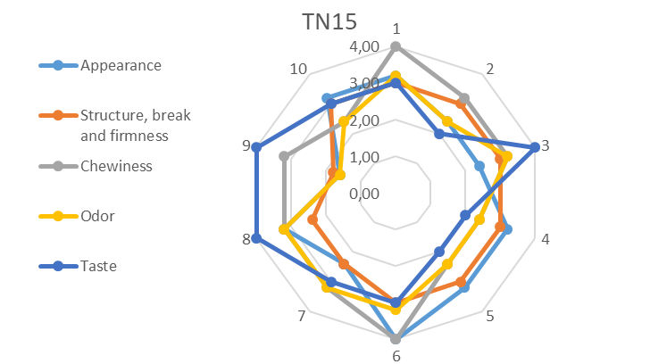
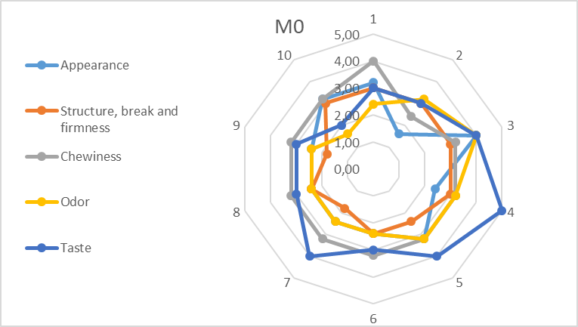
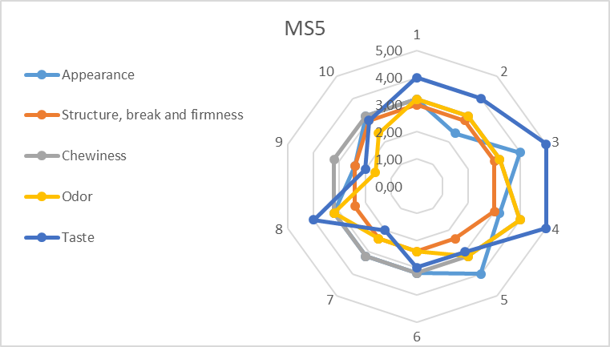
Chocolate with cocoa bean shell

Slide 13
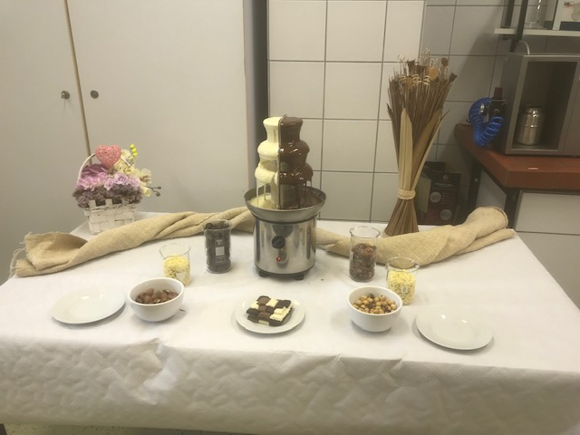
Chocolate with cocoa bean shell
Things to be done – thoughts for future research:
  PAH
  Pesticides
  Consumer testing
  Production in industrial level

Slide 14
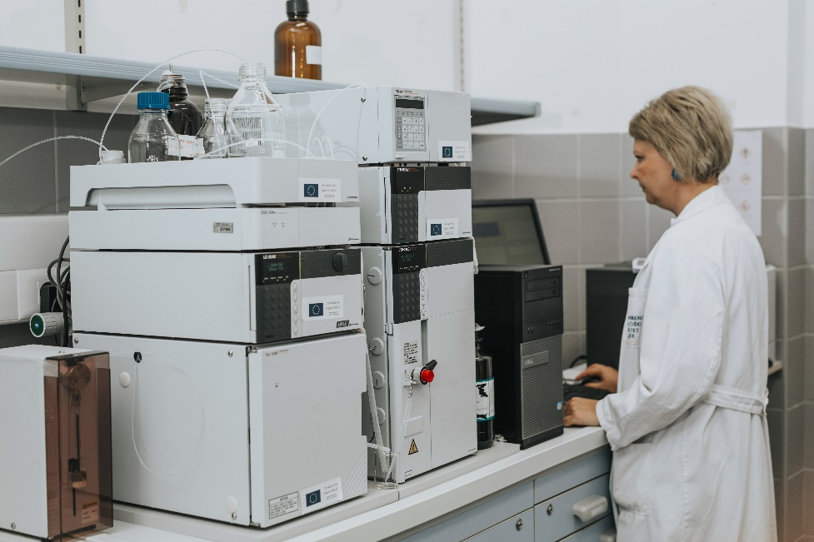
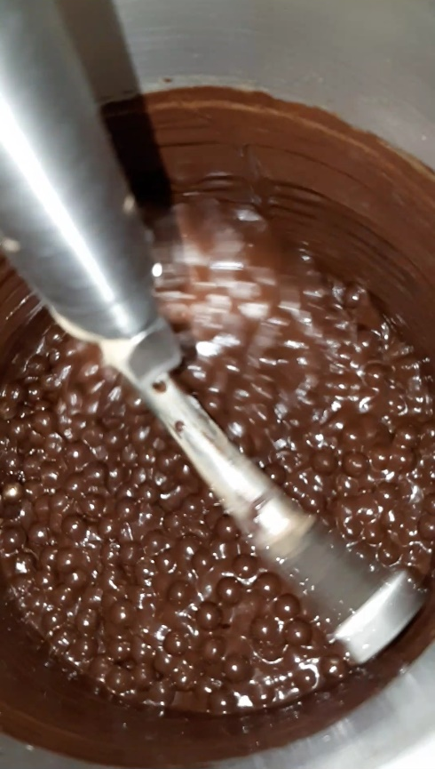
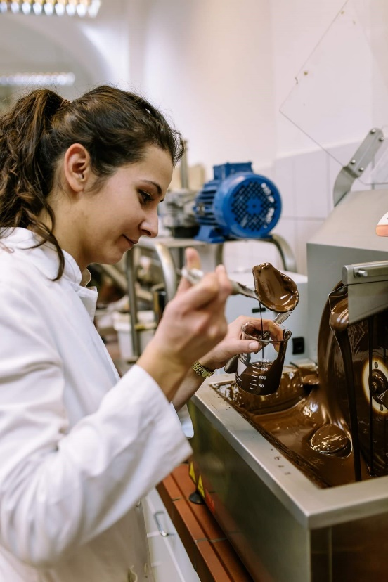


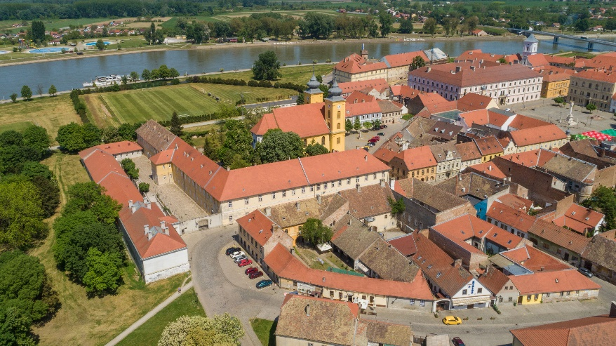
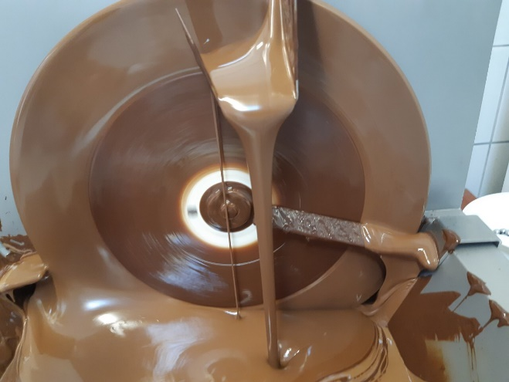
Thank you for your attention!

