Slide 1

Application of Cocoa Shell in the Production of Chocolate and Chocolate-like Products
Đurđica Ačkar, Veronika Barišić, Ivana Flanjak, Jurislav Babić
Josip Juraj Strossmayer University of Osijek
Faculty of Food Technology Osijek, Croatia

Slide 2


HRZZ Installation Research Project
2. 1. 2018 – 1. 1. 2023.
Cocoa shell
Chocolate
Sweet spreads
Instant drinks

Slide 3
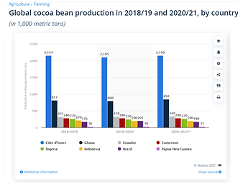
Cocoa bean shell
App. 12 – 20 % of the bean
2020/21: 4,305,000 metric tonns of cocoa bean produced in 8 countries – 688,800 metric tonns of cocoa shell

Slide 4
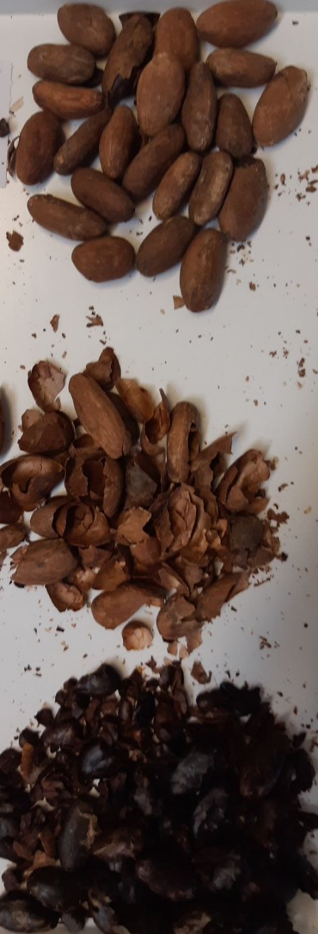
Cocoa bean shell
Mulching
Adsorption
Animal feed
Food – chocolate (?)
Antimicrobial: Streptococcus mutans MT8148R and Streptococcus sobrinus 6715 – dental health (inhibition of caries and plaque development)

Slide 5
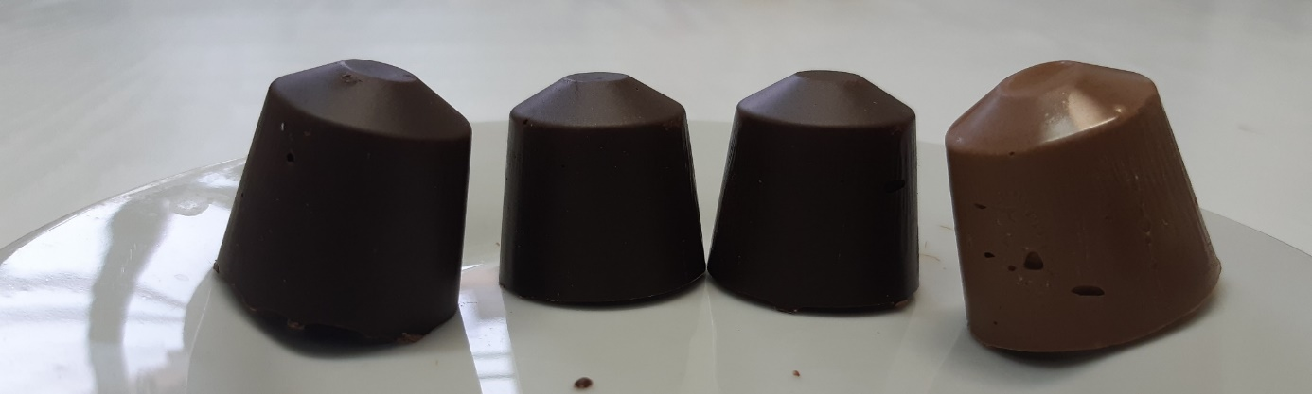
Cocoa bean shell

Slide 6
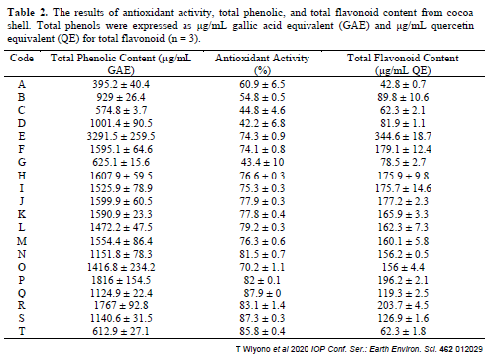
Cocoa bean shell

Slide 7
Cocoa bean shell

Slide 8
HVED treatment
 | 0–50 µm (%) | 51–71 µm (%) | 72–100 µm (%) | 101–125 µm (%) | 126–200 µm (%) | 201–315 µm (%) | >315 µm (%)
UCS | 15.19 | 21.89 | 11.83 | 7.94 | 18.24 | 14.10 | 10.81
1.5%, 15 min | 3.63 | 14.70 | 8.27 | 5.29 | 14.66 | 17.87 | 35.58
1.5%, 30 min | 3.12 | 12.64 | 7.83 | 5.07 | 13.12 | 16.76 | 41.47
1.5%, 45 min | 1.71 | 10.64 | 7.33 | 4.74 | 12.11 | 15.44 | 48.03
1.5%, 15 min, 40 Hz | 5.64 | 13.78 | 7.42 | 5.52 | 13.62 | 17.42 | 36.61
1.5%, 30 min, 40 Hz | 8.39 | 13.47 | 7.33 | 5.16 | 13.35 | 17.51 | 34.80
1.5%, 45 min, 40 Hz | 3.67 | 13.67 | 7.42 | 5.15 | 12.65 | 16.94 | 40.50
1.5%, 15 min, 80 Hz | 5.48 | 10.55 | 6.28 | 4.66 | 11.59 | 15.75 | 45.69
1.5%, 30 min, 80 Hz | 2.64 | 11.71 | 8.59 | 5.50 | 13.33 | 16.75 | 41.48
1.5%, 45 min, 80 Hz | 2.98 | 9.95 | 8.93 | 5.54 | 13.07 | 16.67 | 42.87
3.0%, 15 min | 3.52 | 9.98 | 7.22 | 4.64 | 11.72 | 15.36 | 47.56
3.0%, 30 min | 2.28 | 9.19 | 9.33 | 5.77 | 13.10 | 16.40 | 43.93
3.0%, 45 min | 2.16 | 9.26 | 10.98 | 6.40 | 15.05 | 17.31 | 38.84
3.0%, 15 min, 40 Hz | 1.36 | 8.89 | 11.45 | 5.79 | 15.12 | 18.76 | 38.64
3.0%, 30 min, 40 Hz | 0.64 | 4.04 | 11.23 | 7.40 | 15.23 | 18.69 | 42.77
3.0%, 45 min, 40 Hz | 2.08 | 8.84 | 10.14 | 5.24 | 12.78 | 16.18 | 44.75
3.0%, 15 min, 80 Hz | 1.50 | 11.73 | 10.83 | 6.07 | 15.48 | 19.18 | 35.20
3.0%, 30 min, 80 Hz | 1.32 | 6.51 | 9.05 | 4.92 | 12.47 | 15.72 | 50.01
3.0%, 45 min, 80 Hz | 3.07 | 11.41 | 7.46 | 4.41 | 11.17 | 15.14 | 47.33
FAIL

Slide 9
HVED treatment

Slide 10
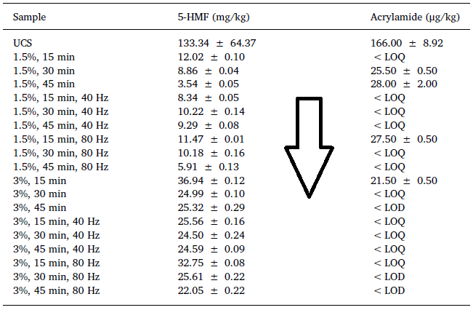
HVED treatment

Slide 11
HVED treatment

Slide 12
HVED treatment

Slide 13
HVED treatment

Slide 14
HVED treatment
Caffeic acid 0%

Slide 15
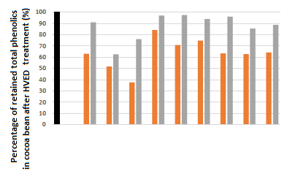

Slide 16
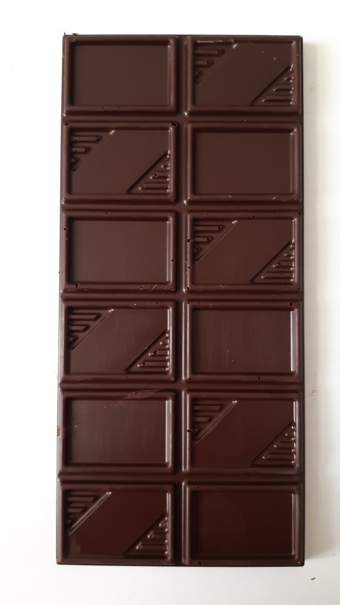
Chocolate – benefits and issues
Sugar, cocoa, (milk), substitute fats, emulsifier
Nutritional benefits:
  Cocoa – polyphenols, Mg
  Milk – Ca
Issues:
  Sugar, cocoa butter, fats – calories
  Diebetes
  Caries
  Obesity

Slide 17
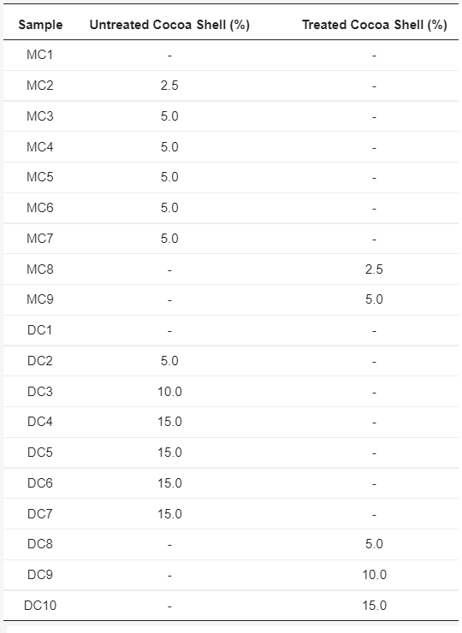
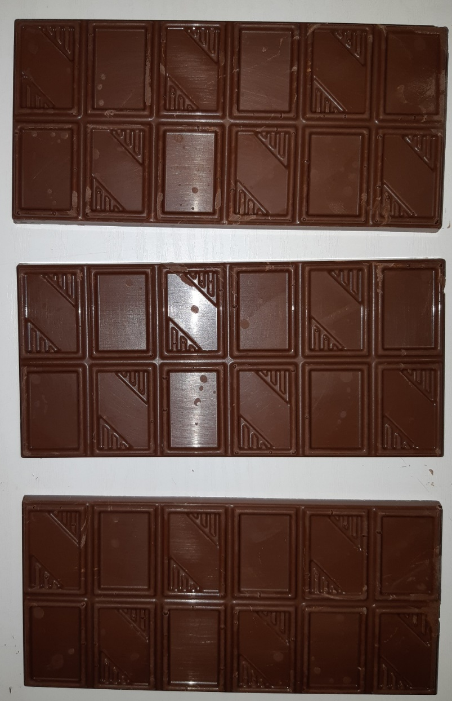
Chocolate with cocoa bean shell

Slide 18
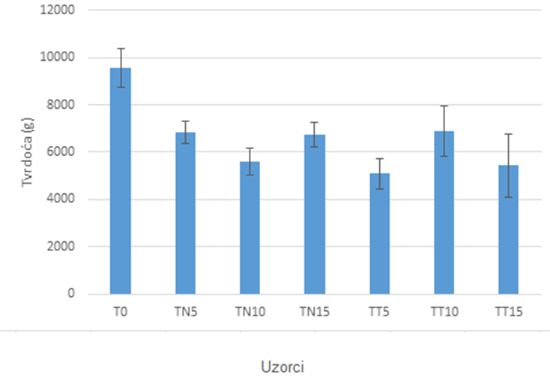
Chocolate with cocoa bean shell
Particle size
Sample | SSA | D[3,4]
T0 | 0.853 ± 0.007 | 12.827 ± 0.115
TN5 | 0.788 ± 0.003 | 15.186 ± 0.171
TN10 | 0.826 ± 0.049 | 17.457 ± 0.347
TN15 | 0.686 ± 0.001 | 19.107 ± 0.18
TT5 | 0.817 ± 0.01 | 17.568 ± 0.249
TT10 | 0.715 ± 0.003 | 22.452 ± 0.244
TT15 | 0.801 ± 0.011 | 20.028 ± 0.386
Texture - hardness

Slide 19
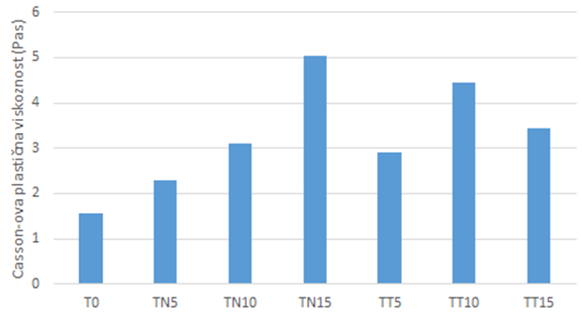
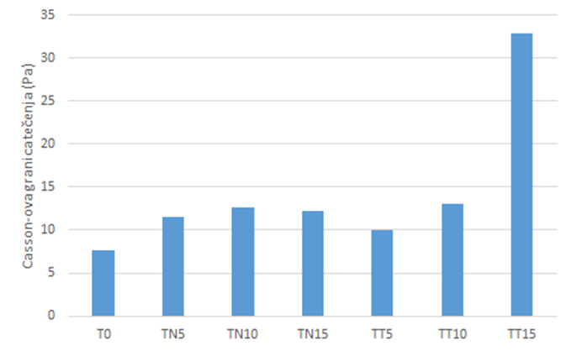
Chocolate with cocoa bean shell
Viscosity properties:
Casson viscosity
Casson yield value

Slide 20
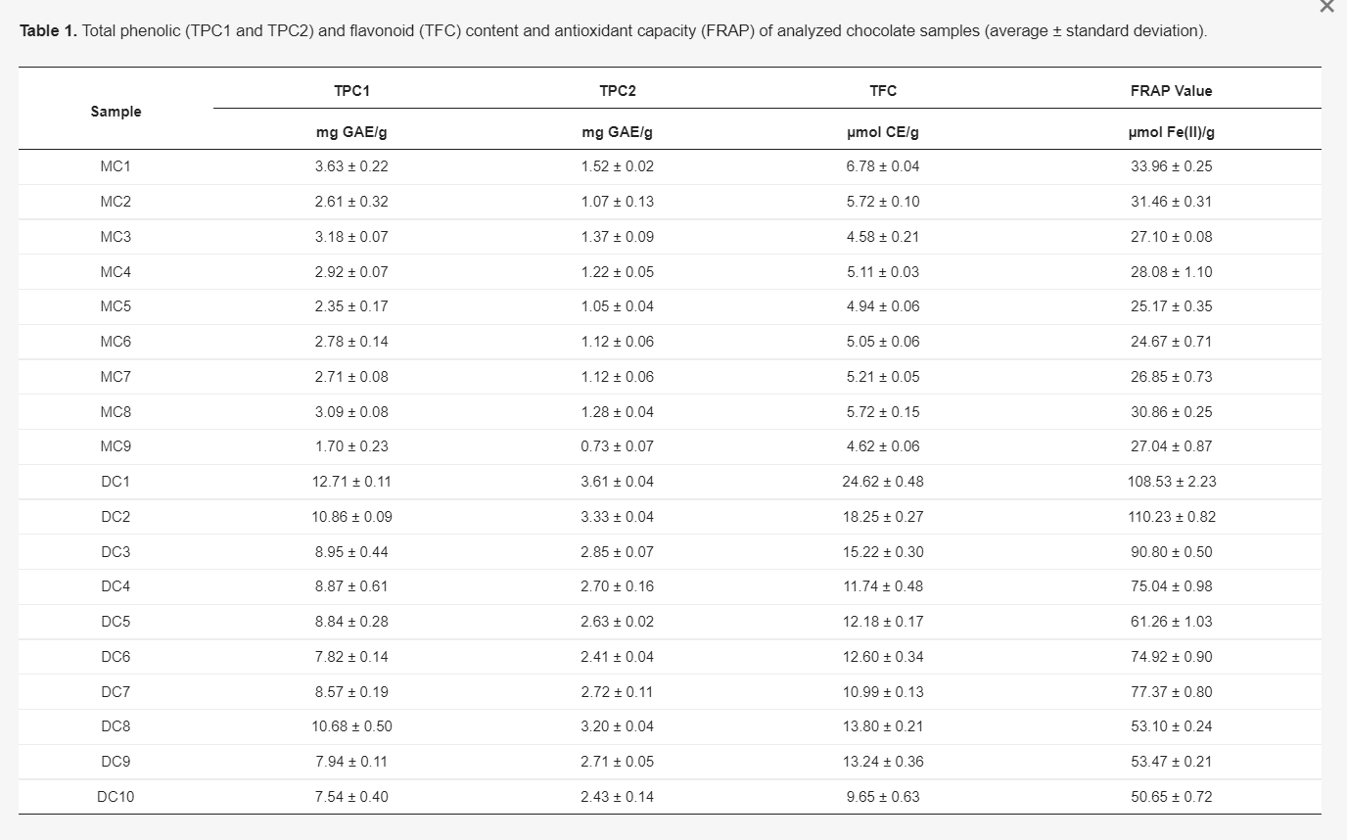
Chocolate with cocoa bean shell
Molecules 2020, 25, 5470; doi:10.3390/molecules25225470

Slide 21
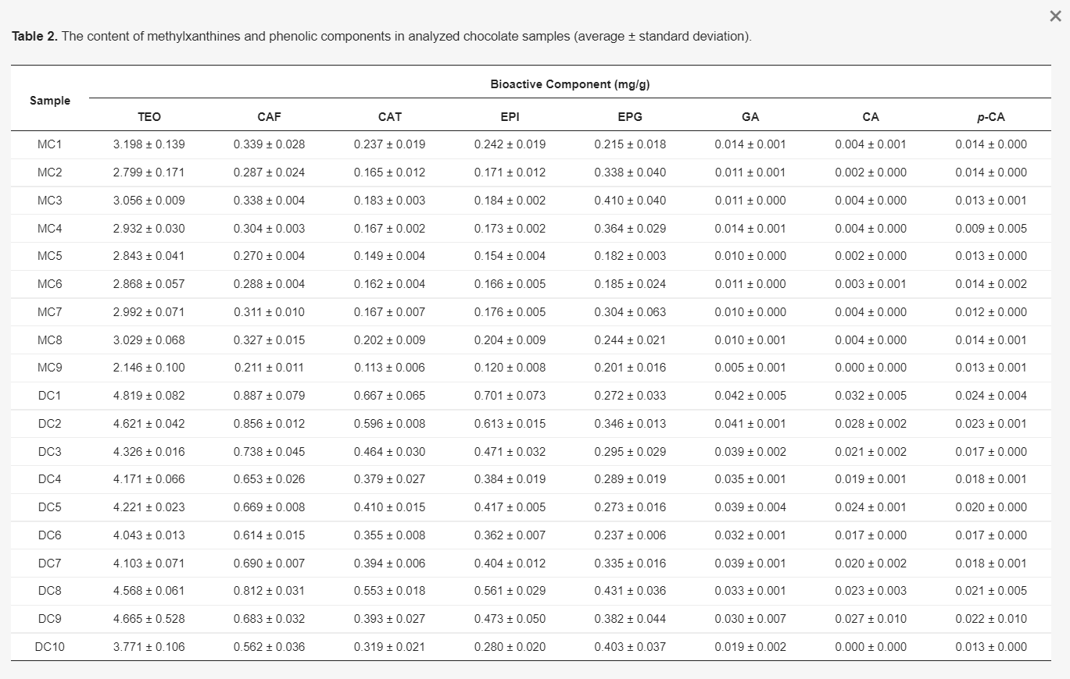
Chocolate with cocoa bean shell
Molecules 2020, 25, 5470; doi:10.3390/molecules25225470

Slide 22
Chocolate with cocoa bean shell
Sample | ⁴⁴Ca (mg/kg) | ²⁴Mg (mg/kg) | ⁵⁶Fe (mg/kg) | ⁵⁷Fe (mg/kg)
D0 | 540.34 ± 85.60ª | 1155.27 ± 15.23^{c} | 202.93 ± 5.00^{c} | 205.17 ± 5.19^{c}
DU5 | 652.65 ± 122.98ª | 1193.20 ± 6.97^{d} | 293.83 ± 2.02e | 298.37 ± 3.90^{f}
DU10 | 867.41 ± 41.96^{b} | 1246.40 ± 8.97e | 328.33 ± 5.09^{f} | 333.00 ± 4.85^{g}
DU15 | 908.28 ± 12.08^{b} | 1313.01 ± 16.19^{g} | 333.50 ± 5.78^{f} | 338.53 ± 3.76^{g}
DT5 | 912.39 ± 51.77^{b} | 1173.36 ± 28.37^{c,d} | 285.67 ± 6.34e | 289.73 ± 4.50^{f}
DT10 | 1035.90 ± 45.71^{b,c} | 1225.87 ± 7.97e | 290.83 ± 1.68e | 297.77 ± 1.06^{f}
DT15 | 1144.39 ± 28.22^{c} | 1279.24 ± 12.35^{f} | 364.33 ± 6.30^{g} | 369.00 ± 8.08^{h}
M0 | 1855.49 ± 91.29^{d,e} | 639.34 ± 12.17^{a,b} | 90.13 ± 1.45ª | 90.55 ± 1.65ª
MU2.5 | 1802.37 ± 221.42^{d,e} | 620.62 ± 11.34ª | 178.77 ± 2.26^{b} | 182.00 ± 2.65^{b}
MU5 | 1955.02 ± 35.22e | 642.17 ± 4.57^{a,b} | 209.90 ± 4.03^{c} | 217.17 ± 3.61^{d}
MT2.5 | 1687.18 ± 6.02 ^{d} | 620.55 ± 7.49ª | 174.50 ± 3.11^{b} | 177.40 ± 4.68^{b}
MT5 | 1836.20 ± 59.51^{d,e} | 656.47 ± 11.05^{b} | 232.20 ± 3.14^{d} | 241.07 ± 4.82e

Slide 23
Chocolate with cocoa bean shell
Contents of toxic elements in chocolates with cocoa shell
Sample | ⁶⁰Ni (mg/kg) | ⁵²Cr (mg/kg) | ²⁰⁸Pb (µg/kg) | ¹¹¹Cd (µg/kg) | ²³⁸U (µg/kg)
D0 | 2.59 ± 0.041^{b} | 2.96 ± 0.085^{b} | 44.41 ± 3.82^{b} | 18.95 ± 0.34^{b} | <LD
DU5 | 5.73 ± 0.119e | 10.83 ± 0.144^{e,f} | 99.84 ± 0.81e | 48.52 ± 1.40^{d} | 0.29 ± 0.00ª
DU10 | 6.76 ± 0.148^{g} | 12.89 ± 0.128^{h} | 139.17 ± 3.63^{f} | 74.71 ± 1.34e | 2.24 ± 0.63^{b}
DU15 | 6.67 ± 0.065^{g} | 12.52 ± 0.249^{h} | 194.10 ± 2.50^{h} | 101.73 ± 1.46^{g} | 6.32 ± 0.55^{c}
DT5 | 5.77 ± 0.111e | 11.10 ± 0.259^{f} | 91.50 ± 1.71^{d} | 49.50 ± 1.44^{d} | <LD
DT10 | 5.65 ± 0.090e | 10.67 ± 0.066^{d,e} | 140.90 ± 2.84^{f} | 79.17 ± 1.54^{f} | 3.19 ± 0.11^{b}
DT15 | 8.66 ± 0.129^{h} | 17.81 ± 0.215^{j} | 185.60 ± 8.21^{g} | 105.30 ± 1.19^{h} | 5.43 ± 0.83^{c}
possibly carcinogenic
possibly carcinogenic
carcinogenic
Bertoldi et al. (2016)
3.28 – 4.67 mg/kg
0.25 – 1.72 mg/kg
8.3 – 23.5 µg/kg
144 – 615 µg/kg
0.44 – 0.98 µg/kg

Slide 24
Chocolate with cocoa bean shell
Contents of toxic elements in chocolates with cocoa shell
Sample | ⁶⁰Ni (mg/kg) | ⁵²Cr (mg/kg) | ²⁰⁸Pb (µg/kg) | ¹¹¹Cd (µg/kg) | ²³⁸U (µg/kg)
M0 | 1.25 ± 0.065ª | 1.68 ± 0.017ª | 26.48 ± 4.99ª | 5.05 ± 0.70ª | <LD
MU2.5 | 4.66 ± 0.071^{c} | 10.28 ± 0.172^{c,d} | 45.02 ± 1.78^{b} | 19.89 ± 1.01^{b} | <LD
MU5 | 5.09 ± 0.115^{d} | 11.52 ± 0.425^{g} | 72.39 ± 0.81^{c} | 32.99 ± 1.15^{c} | <LD
MT2.5 | 4.45 ± 0.095^{c} | 9.92 ± 0.063^{c} | 46.92 ± 3.56^{b} | 19.42 ± 1.32^{b} | <LD
MT5 | 6.10 ± 0.131^{f} | 14.10 ± 0.198^{i} | 72.35 ± 2.96^{c} | 33.94 ± 1.46^{c} | <LD
possibly carcinogenic
possibly carcinogenic
carcinogenic
Bertoldi et al. (2016)
3.28 – 4.67 mg/kg
0.25 – 1.72 mg/kg
8.3 – 23.5 µg/kg
144 – 615 µg/kg
0.44 – 0.98 µg/kg

Slide 25
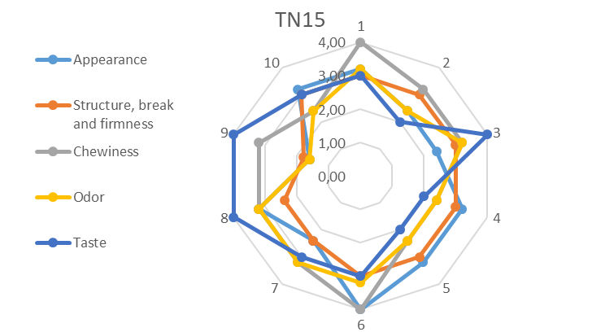
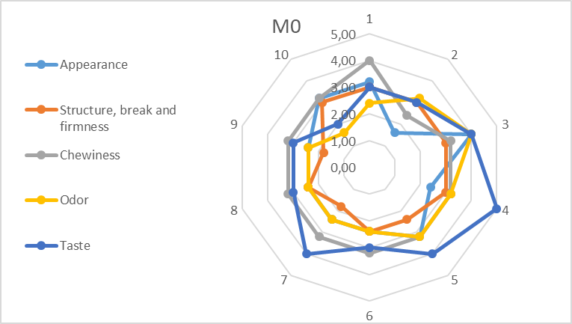
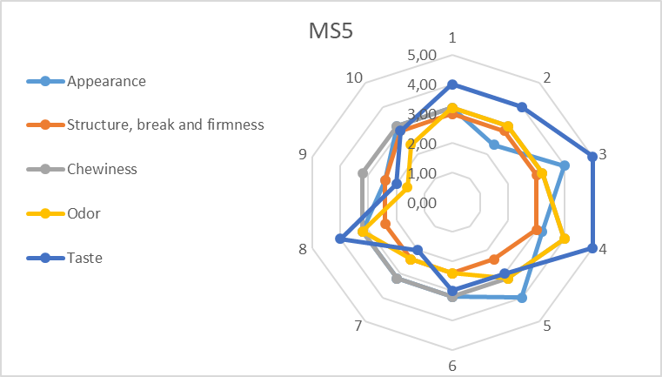
Chocolate with cocoa bean shell

Slide 26
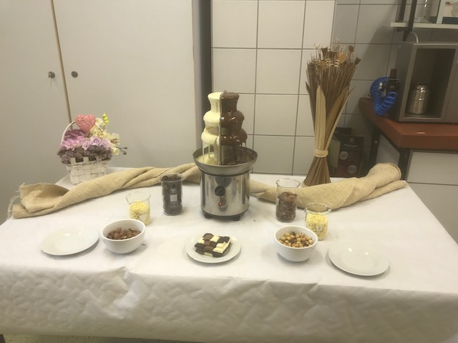
Chocolate with cocoa bean shell
Things to be done – thoughts for future research:
  PAH
  Pesticides
  Consumer testing
  Production in industrial level

Slide 27
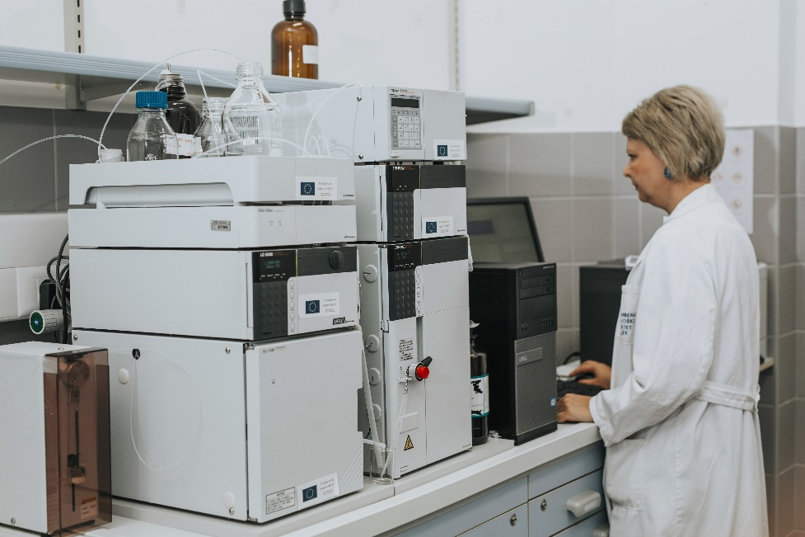
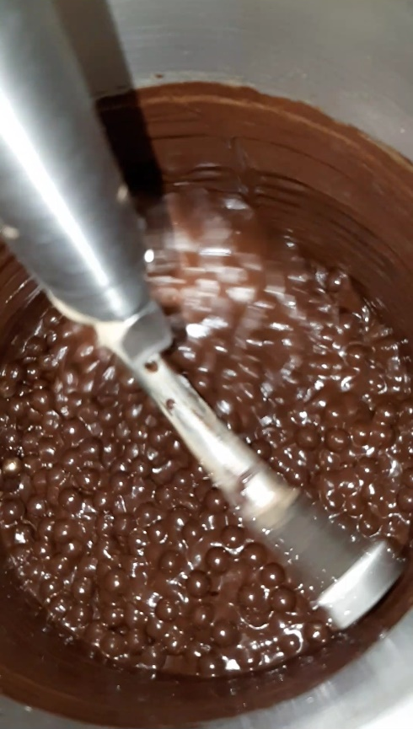
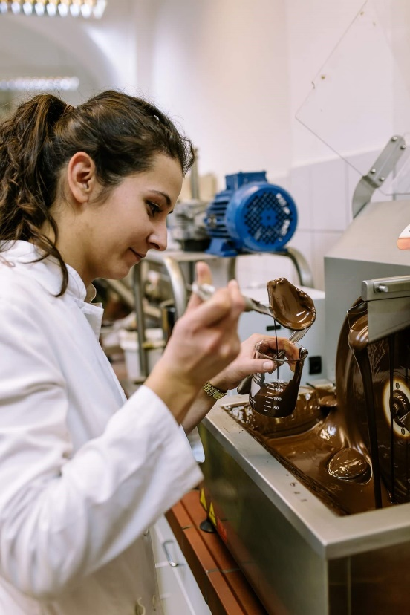

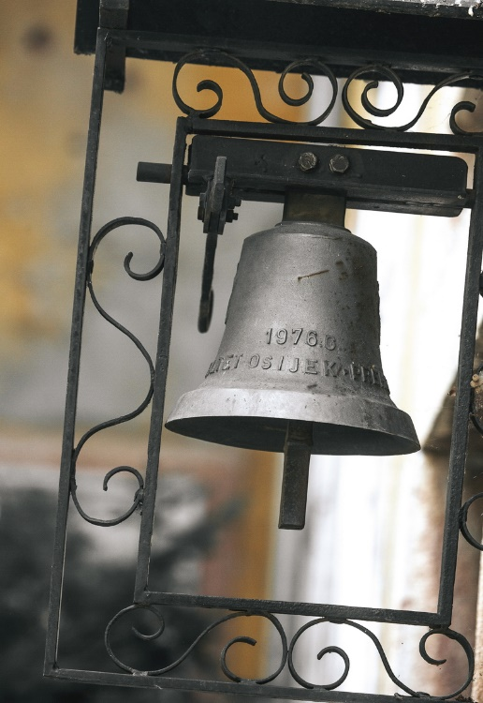
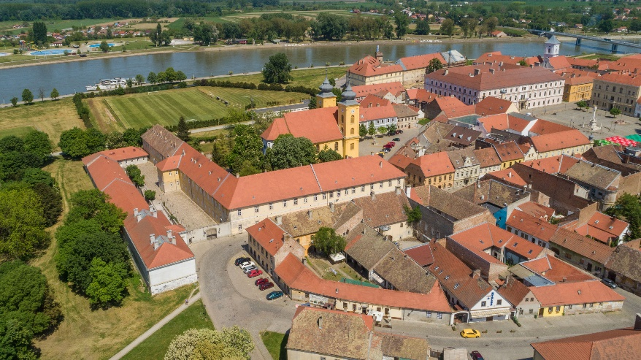
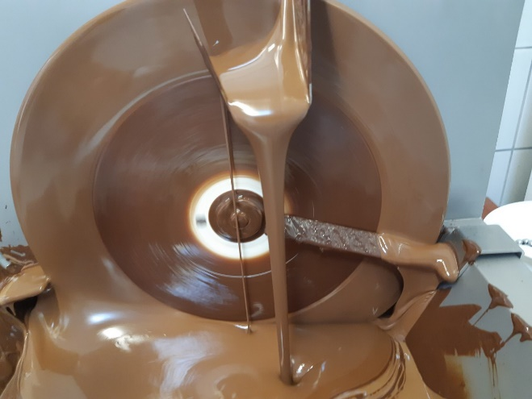
Thank you for your attention!

